Slide 1

Advance Projects Guide
By:
Wisam N. Abu Karsh
NID@L M. Alburbar
Mohammed Hajjaj
Khaled Al Basayna
Wajed Saleem

Slide 2
What are the tools we use.
What’s Our Project do.
Out put Snapshoot

Slide 3
Tool (1) Paper & Pen

Slide 4


Slide 5
Tool (2) Smart Sheet

Slide 6
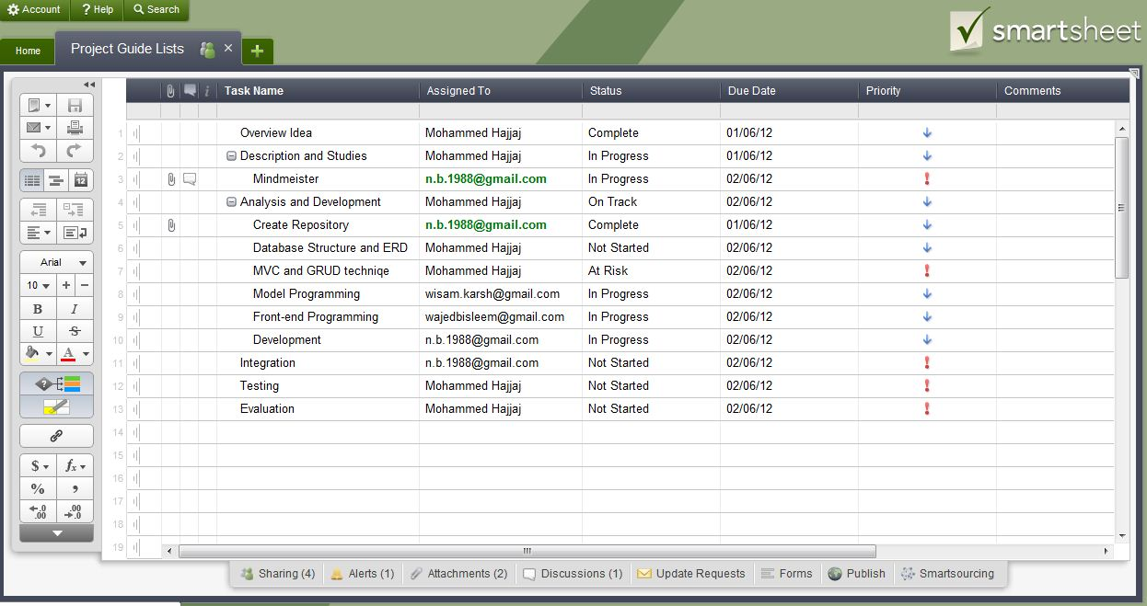

Slide 7
Tool (3) MindMeister

Slide 8
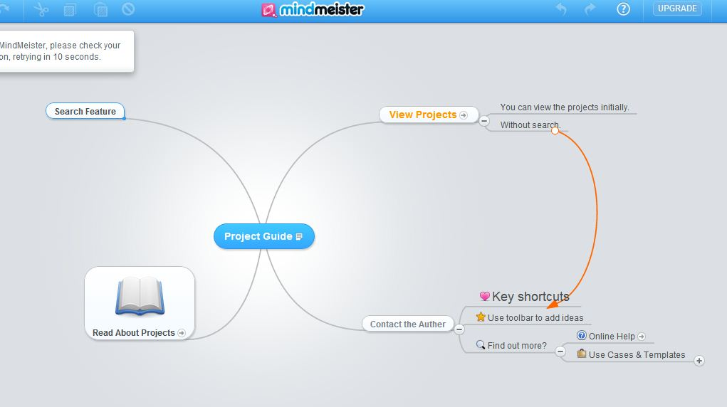

Slide 9
Tool (4) GitHub

Slide 10
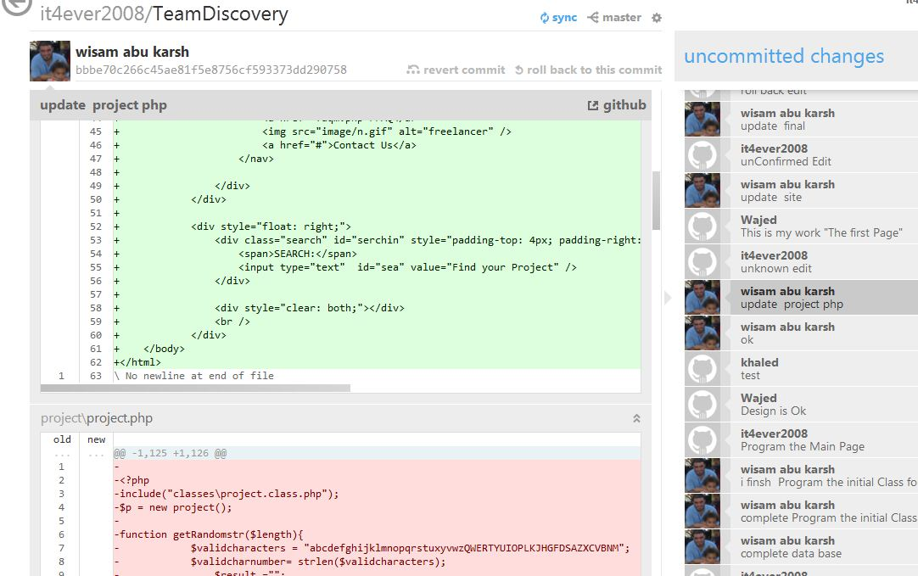

Slide 11
Tool (5) Cocoo – ER Diagram

Slide 12
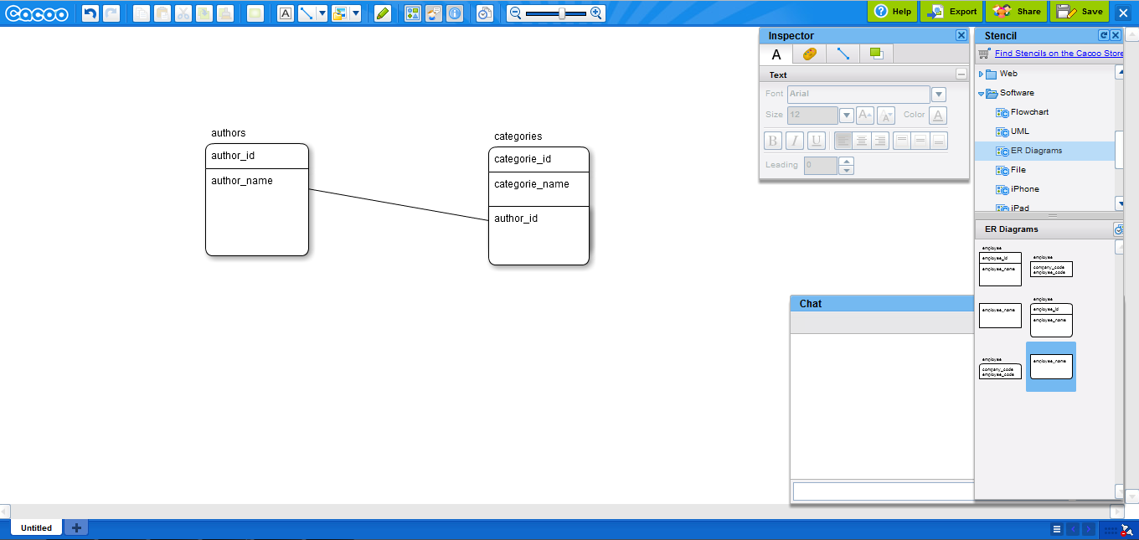

Slide 13

View Projects
What’s Our Project do
Searching for Projects
Add Projects

Slide 14


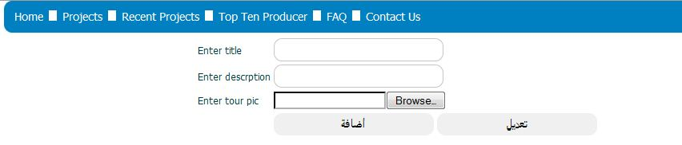
Out put Snapshoot

Slide 15
Thank you
For
Listening
☺

